Slide 1
Seminar On
LI-FI
Presented by-
RUBINA IBRAHIM

Slide 2
Li-Fi can be thought of as a light-based Wi-Fi. That is, it uses light instead of radio waves to transmit information.
And instead of Wi-Fi modems, Li-Fi would use transceiver-fitted LED lamps that can light a room as well as transmit and receive information.

Slide 3
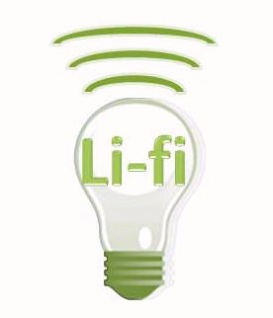
WHAT IS LI – FI ?
LI-FI is transmission of data through illumination ,ie sending data through a LED light bulb that varies in intensity faster than human eye can follow
LI FI- LIGHT FIDEALITY

Slide 4
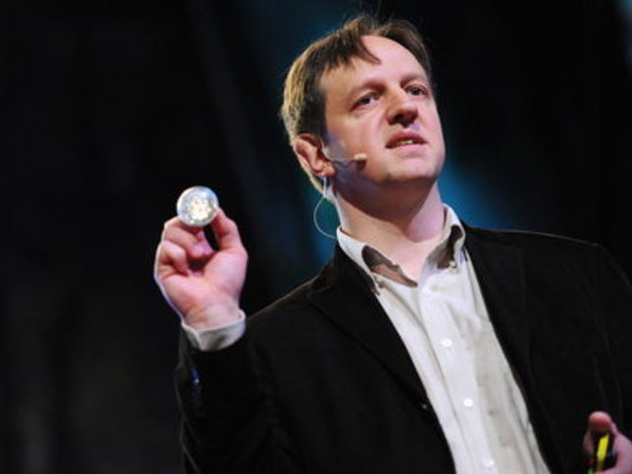
HISTORY-
The technology truly began during the 1990's in countries like Germany, Korea, and Japan where they discovered LED's could be retrofitted to send information. Harald Haas continues to wow the world with the potential to use light for communication
HARALD HASS

Slide 5

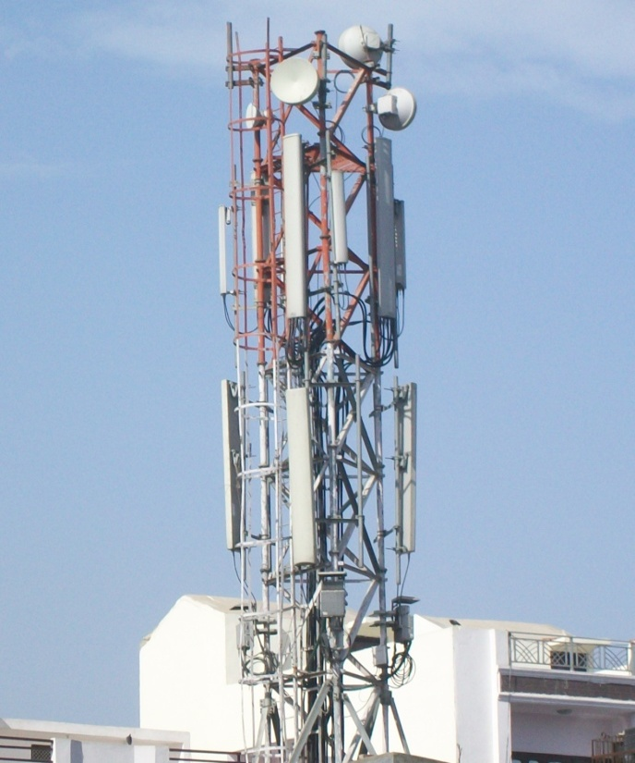
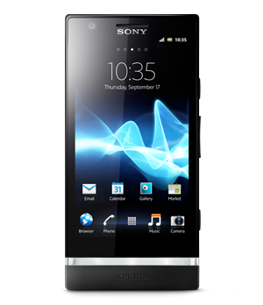
PRESENT SCENARIO
5 Billion
1.4 Million
Radio Spectrum is congested but the demand for wireless data double each year .Every thing, it seems want to use wireless data but the capacity is drying up.

Slide 6
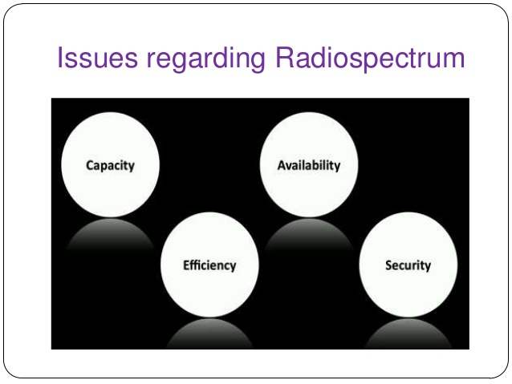

Slide 7
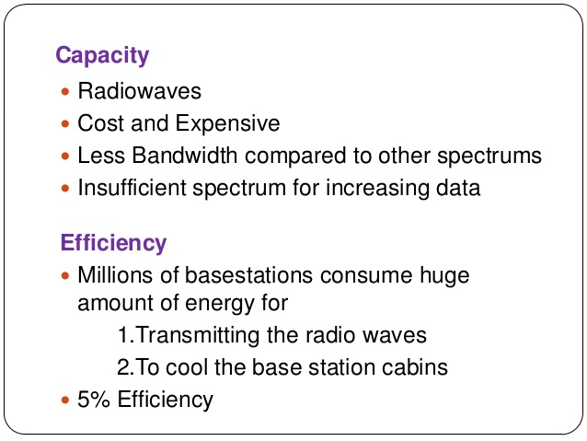
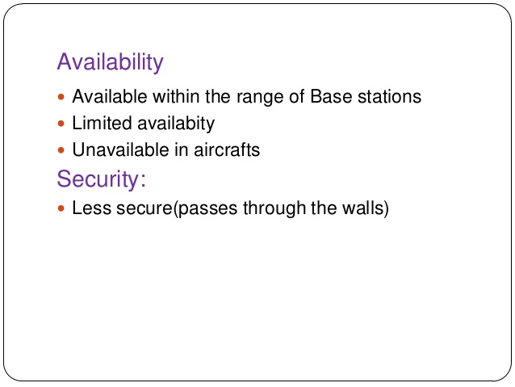

Slide 8
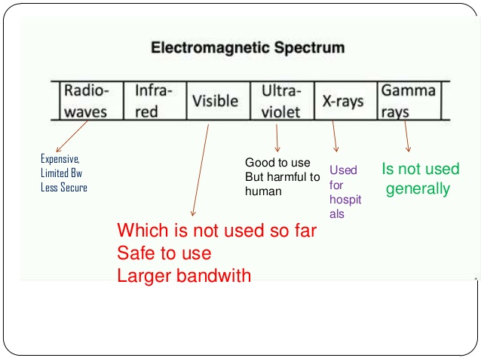

Slide 9
WHY ONLY VLC
Radio Waves
Infrared Rays
Visible Rays
Ultraviolet Rays
X- Rays
Gama Rays
Gama rays cant be used as they could be dangerous.
X-rays have similar health issues.
Ultraviolet light is good for place without people, but other wise dangerous for the human body.
Infrared, due to eye safety regulation, can only bse used with low power.
HENCE WE LEFT WITH THE ONLY THE VISIBLE - LIGHT SPECTRUM.

Slide 10
WHO CAN REPLACE
RADIO WAVES FOR WIRELESS
COMMUNICATION ?

Slide 11

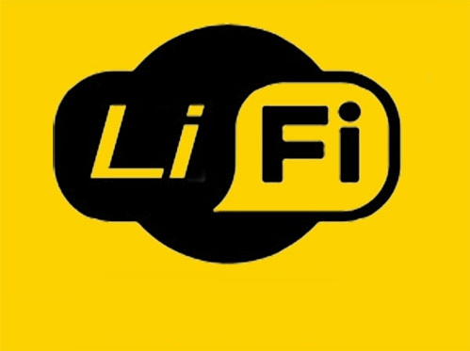

Slide 12
Basic concepts-
LED ie Light emitting diode can be switched on and off faster since operating speed of LED is less than 1 μs, than the human eye can detect, causing the light source to be appear continuously. This invisible on-off activity enables a kind of data transmission using binary codes. Switching on and LED is a logical ‘1’, switching it off is a logical ‘0’.It is possible to encode data in the light by varying the rate at which LED’s flicker on and off to give different strings of 1s and 0s. Modulation is so fast that human eye doesn’t notice

Slide 13


How LI-FI Works ?
operational procedure is very simple, if the led is on, you transmit a digital 1, if its off you transmit a 0. The LEDs can be switched on and off very quickly, which gives nice opportunities for transmitting data. Hence all that us required is some LEDS and a controller that code data into those LEDs. We have to just vary the rate at which the LED’s
flicker depending upon the data we want to encode
Thus every light source will
works as a hub for data
transmission

Slide 14
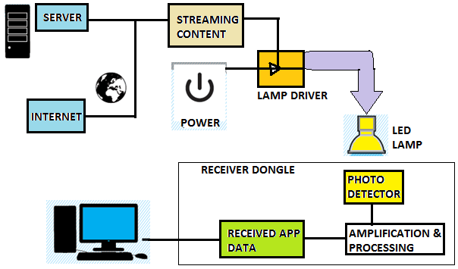

Slide 15
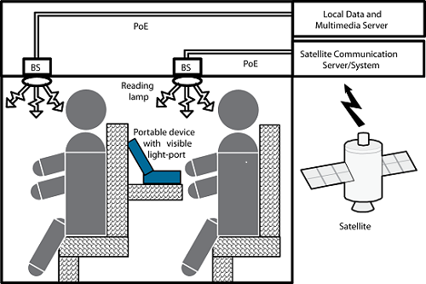

Slide 16
On one end all the data on the internet will be streamed to a lamp driver when the led is turned on the microchip converts the digital data in form of light
A light sensitive device (photo detector) receives the signal and converts it back into original data. This method of using rapid pulses of light to transmit information wirelessly is technically referred as Visible Light Communication

Slide 17
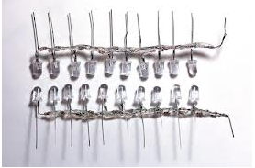
Further enhancements can be made in this method, like using an array of LEDs for parallel data transmission, or using mixtures of red, green and blue LEDs to alter the light‘s frequency with each frequency encoding a different data channel. Such advancements promise a theoretical speed of 10 Gbps – meaning one can download a full high-definition film in just 30 seconds

Slide 18
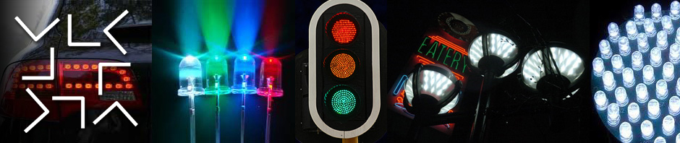
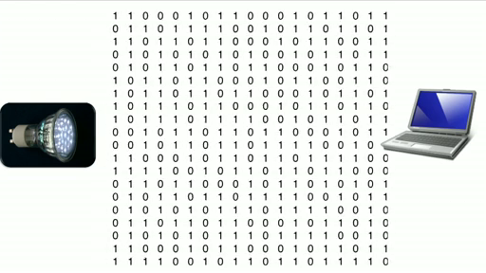

Slide 19
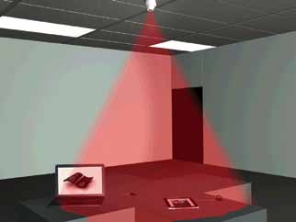
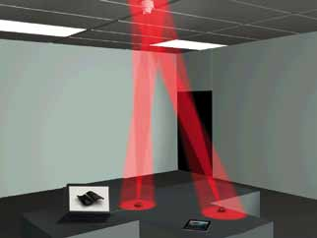
Giga shower
Giga mimo
For giga-speed technologies, the Li-Fi Consortium defined GigaShower, GigaSpot and GigaMIMO models

Slide 21
POTENTIAL APPLICATION OF LI-FI
Li Fi technology is still in its infancy .However some areas where it seems perfectly applicable are:-
1- TRAFFIC LIGHTS
Traffic lights can communicate to the car and with each other. Cars have LED-based headlights, LED-based cack lights, and cars can communicate with each other and prevent accidents in by exchanging information.

Slide 22
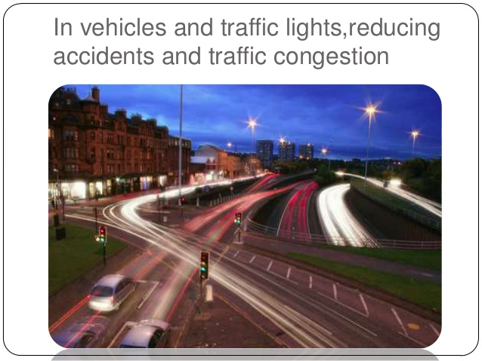

Slide 23
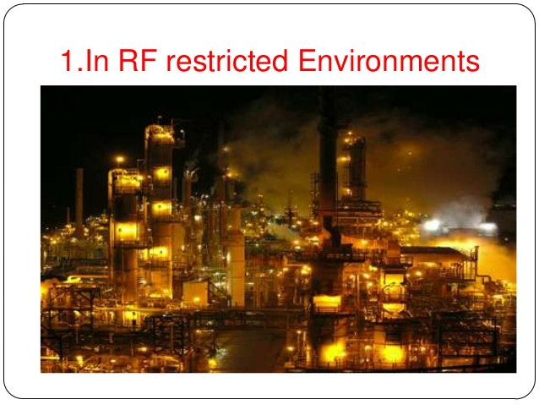
2-INTRINSICALLY SAFE ENVIRONMENT
Visible Light is more safe than RF, hence it can be used in places where RF can't be used such as petrochemical plants .

Slide 24

3- Airlines
Whenever we travel through airways we face the problem in communication media ,because the whole airways communication are performed on the basis of radio waves. To overcomes this drawback on radioways , li-fi is introduced.

Slide 25
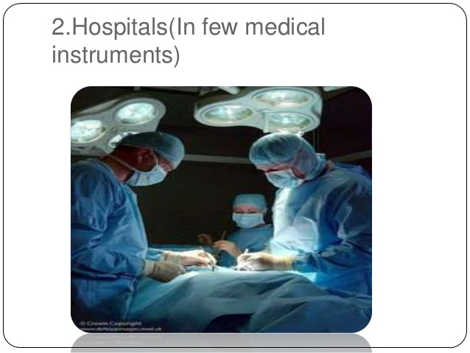

Slide 26
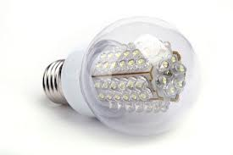
4- ON OCEAN BEDS
Li-Fi can even wok underwater were Wi-Fi fails completely, thereby throwing open endless opportunities for military/navigation operations.

Slide 27
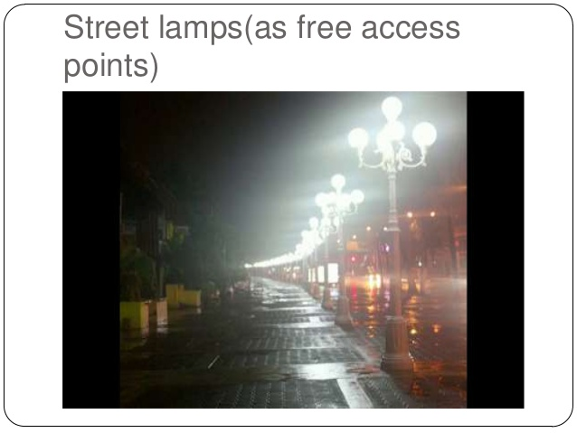
PUBLIC INTERNET HOTSPOTS
There are millions of street lamps deployed around the world.
Each of these street lamps could be a free access point.

Slide 28
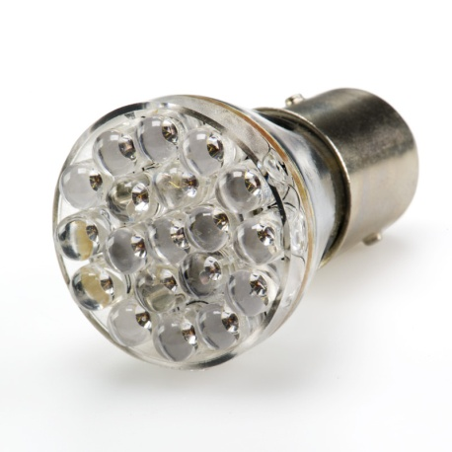
It will reduce your electricity bill and maintainance bill

Slide 29
Limitations 0r challenges-
# light can't pass through objects
#. Interferences from external light sources like sun light, normal bulbs, and opaque materials in the path of transmission will cause interruption in the communication.
#High installation cost of the VLC systems
#A major challenge facing Li-Fi is how the receiving device will transmit back to transmitter.

Slide 30

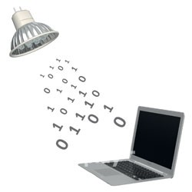
CONCLUSION
The possibilities are numerous and can be explored further. If this technology can be put into practical use , every bulb can be used something like a Wi-Fi hotspots to transmit wireless data.

Slide 31

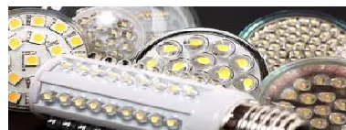
THANKU FOR YOUR
TIME

